Slide 1
CS 106A, Lecture 8 Characters and Strings
suggested reading:
Java Ch. 8.1-8.4

Slide 2
Plan For Today
Announcements
Recap
Parameters
Return
Random Numbers
Text Processing
Characters
Strings
Notes:
Big recap of parameters and return values because that's a super important topic
new variable type Strings with whatever time we have left

Slide 3
Announcements
HW 2 reminder: some features not allowed
Prohibited: parameters, returns, Strings, global variables, anything after 7/3 lecture
Allowed: constants, Math.sqrt
Output comparison tool updated (see site)
Exam conflict form due today at 5PM
See Midterm link on website’s sidebar
Colin’s office hours updated

Slide 4
Plan For Today
Announcements
Recap
Parameters
Return
Random Numbers
Text Processing
Characters
Strings

Slide 5
Parameters
Parameters let you provide a method some information when you are calling it.
Notes:
From last time

Slide 6
Return
Return values let you give back some information when a method is finished.
Notes:
Return and parameters can be used independently or together

Slide 7

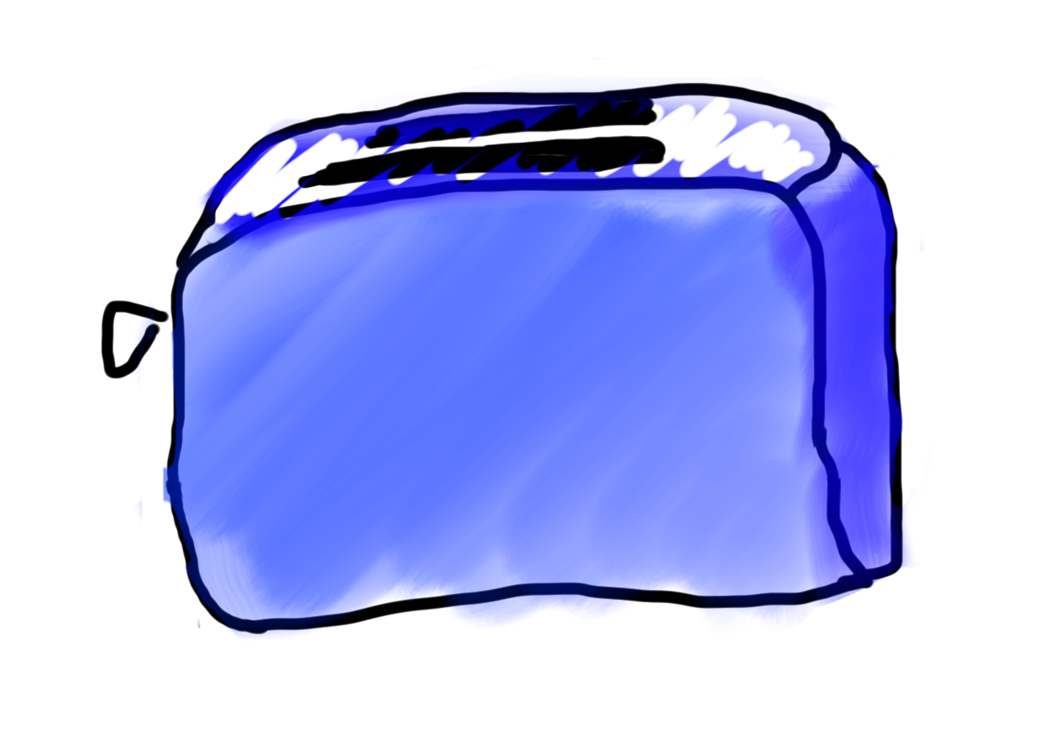
Methods = Toasters
parameter

Slide 8

Methods = Toasters
parameter

Slide 9
Methods = Toasters

Slide 10

Methods = Toasters

Slide 11

Methods = Toasters
return
Notes:
One example we have already seen is…

Slide 12
Example: readInt
int x = readInt(”Your guess? ");

Slide 13
Example: readInt
int x = readInt(”Your guess? ");
We call readInt
We give readInt some information (the text to print to the user)

Slide 14
Example: readInt
int x = readInt(”Your guess? ");
When we include values in the parentheses of a method call, this means we are passing them as parameters to this method.
Notes:
PAR PAR BINKS

Slide 15
Example: readInt
int x = readInt(”Your guess? ");
When we include values in the parentheses of a method call, this means we are passing them as parameters to this method.
Mesa love puttin’ bread in toasters!
Par Par Binks
Parameters in Parentheses
Notes:
PAR PAR BINKS

Slide 16
Example: readInt
int x = readInt(”Your guess? ");
When finished, readInt gives us information back (the user’s number) and we put it in x.

Slide 17
Example: readInt
int x = readInt(”Your guess? ");
When we set a variable equal to a method, this tells Java to save the return value of the method in that variable.
Notes:
TARTL

Slide 18
Example: readInt
int x = readInt(”Your guess? ");
When we set a variable equal to a method, this tells Java to save the return value of the method in that variable.
tARtL
to Assign, Right to Left
Notes:
TARTL

Slide 19
Plan For Today
Announcements
Recap
Parameters
Return
Random Numbers
Text Processing
Characters
Strings
The following drawBox example has animations that do not show up in the lecture slides—please watch the lecture video

Slide 20
Parameters Example: drawBox
Tells Java this method needs two ints in order to execute.
private void drawBox(int width, int height) {
// use width and height variables
// to draw a box
}
Notes:
drawBox takes the size of the box to draw, and draws an asterisk box to the screen

Slide 21
Parameters Example: drawBox
Inside drawBox, refer to the first parameter value as width…
private void drawBox(int width, int height) {
// use width and height variables
// to draw a box
}

Slide 22
Parameters Example: drawBox
…and the second parameter value as height.
private void drawBox(int width, int height) {
// use width and height variables
// to draw a box
}

Slide 23
drawBox
We give drawBox some information (the size of the box we want)
We call drawBox
drawBox(7, 4);
Notes:
We can also pass variable values as parameters too

Slide 24
drawBox
int width = readInt("Width? ");
int height = readInt("Height? ");
...
drawBox(width, height);
We give drawBox some information (the size of the box we want)
We call drawBox
Notes:
Let’s dive more in depth

Slide 25
drawBox
int width = readInt("Width? "); 7
int height = readInt("Height? "); 4
...
drawBox(width, height);

Slide 26
drawBox
int width = readInt("Width? "); 7
int height = readInt("Height? "); 4
...
drawBox(width, height);
7
4

Slide 27
drawBox
int width = readInt("Width? "); 7
int height = readInt("Height? "); 4
...
drawBox(7, 4);
Notes:
This is LIKE replacing width and height with the actual numbers

Slide 28
drawBox
First parameter to drawBox
Second parameter to drawBox
7
4
Notes:
the fact that these values came from variables doesn't matter by the time we're executing the method

Slide 29
drawBox
7
4
private void drawBox(int width, int height) {
// use width and height variables
// to draw a box
}
Notes:
transition immediately

Slide 30
drawBox
7
4
private void drawBox(int width, int height) {
// use width and height variables
// to draw a box
}
Notes:
explain local scope

Slide 31
drawBox
7
4
private void drawBox(int width, int height) { ...
}
drawBox
width height
7
4

Slide 32
Parameter Names
Parameter names do not affect program behavior.

Slide 33
Parameter Names
public void run() {
int width = readInt("Width? "); 7
int height = readInt("Height? "); 4
drawBox(width, height);
}
private void drawBox(int width, int height) {
...
}
run
width height
drawBox
width height
7
4
7
4
Notes:
We can change the parameter names inside drawBox or the variable names in run to anything

Slide 34
Parameter Names
public void run() {
int w = readInt("Width? "); 7
int h = readInt("Height? "); 4
drawBox(w, h);
}
private void drawBox(int width, int height) {
...
}
run
w h
drawBox
width height
7
4
7
4
Notes:
We can change the parameter names inside drawBox or the variable names in run to anything

Slide 35
Parameter Names
public void run() {
int width = readInt("Width? "); 7
int height = readInt("Height? "); 4
drawBox(width, height);
}
private void drawBox(int w, int h) {
...
}
run
width height
drawBox
w h
7
4
7
4

Slide 36
Plan For Today
Announcements
Recap
Parameters
Return
Random Numbers
Text Processing
Characters
Strings

Slide 37
Return Example: metersToCm
When this method finishes, it will return a double.
private double metersToCm(double meters) {
...
}
Notes:
Void meant nothing was returned

Slide 38
Return Example: metersToCm
private double metersToCm(double meters) {
double centimeters = meters * 100;
return centimeters;
}
Returns the value of this expression (centimeters).
Notes:
Now how do we use this?

Slide 39
Return Example: metersToCm
public void run() {
double cm = metersToCm(5.0);
...
}
Setting a variable equal to a method means we save the method’s return value in that variable.
Notes:
When we set a variable equal to a method, this tells Java to save the return value in that variable

Slide 40
Return Example: metersToCm
public void run() {
double meters = readDouble("# meters? ”);
...
double cm = metersToCm(meters);
println(cm + " centimeters.");
}
private double metersToCm(double meters) {
double centimeters = meters * 100;
return centimeters;
}
Notes:
Let’s dive more in depth

Slide 41
Return Example: metersToCm
7.0
public void run() {
double meters = readDouble("# meters? ”);
...
double cm = metersToCm(meters);
println(cm + " centimeters.");
}
private double metersToCm(double meters) {
double centimeters = meters * 100;
return centimeters;
}

Slide 42
Return Example: metersToCm
7.0
public void run() {
double meters = readDouble("# meters? ”);
...
double cm = metersToCm(meters);
println(cm + " centimeters.");
}
private double metersToCm(double meters) {
double centimeters = meters * 100;
return centimeters;
}
7.0

Slide 43
Return Example: metersToCm
7.0
public void run() {
double meters = readDouble("# meters? ”);
...
double cm = metersToCm(meters);
println(cm + " centimeters.");
}
private double metersToCm(double meters) {
double centimeters = meters * 100;
return centimeters;
}
7.0
700.0
Notes:
Doesn’t return the centimeters variable – returns its value

Slide 44
Return Example: metersToCm
7.0
public void run() {
double meters = readDouble("# meters? ”);
...
double cm = metersToCm(meters);
println(cm + " centimeters.");
}
700.0

Slide 45
Return Values and Expressions
7.0
public void run() {
double meters = readDouble("# meters? ”);
println(metersToCm(meters) + " cm.");
}
private double metersToCm(double meters) {
...
}
Notes:
Can also use the method directly as a value – just replace it with its return value

Slide 46
Return Values and Expressions
7.0
public void run() {
double meters = readDouble("# meters? ”);
println(metersToCm(meters) + " cm.");
}
private double metersToCm(double meters) {
...
}
700.0
You can use a method’s return value directly in an expression.
Notes:
With more complex calculations, return lets you write code once to return various values

Slide 47
Buggy Example!
7.0
public void run() {
double meters = readDouble("# meters? ”);
...
metersToCm(meters); // Does nothing!
...
}

Slide 48
Buggy Example!
7.0
public void run() {
double meters = readDouble("# meters? ”);
...
metersToCm(meters); // Does nothing!
...
}
700.0
Notes:
Just like writing a line that is 700;

Slide 49
Factorial Code Walkthrough
See extra slides
Notes:
11:45

Slide 50
Plan For Today
Announcements
Recap
Parameters
Return
Random Numbers
Text Processing
Characters
Strings

Slide 51
RandomGenerator
import acm.util.*;
// random number from 0-9 inclusive
int digit = RandomGenerator.getInstance().nextInt(0, 9);
println(digit);
// prints "hello!" between 3-6 times
int times = RandomGenerator.getInstance().nextInt(3, 6);
for (int i = 0; i < times; i++) {
println("hello!");
}
Method | Description
RandomGenerator.getInstance().nextInt(min, max) | a random integer in the given range, inclusive
Notes:
This is most common. But you can generate other things

Slide 52
RandomGenerator
The RandomGenerator class defines the following methods:
int nextInt(int low, int high)
Returns a random int between low and high, inclusive.
int nextInt(int n)
Returns a random int between 0 and n - 1.
double nextDouble(double low, double high)
Returns a random double d in the range low ≤ d < high.
double nextDouble()
Returns a random double d in the range 0 ≤ d < 1.
boolean nextBoolean()
Returns a random boolean value, which is true 50 percent of the time.
boolean nextBoolean(double p)
Returns a random boolean, which is true with probability p, where 0 ≤ p ≤ 1.
Color nextColor()
Returns a random color.
Notes:
nextDouble's range does not include high!

Slide 53
Plan For Today
Announcements
Recap
Parameters
Return
Random Numbers
Text Processing
Characters
Strings

Slide 54




Text Processing

Slide 55
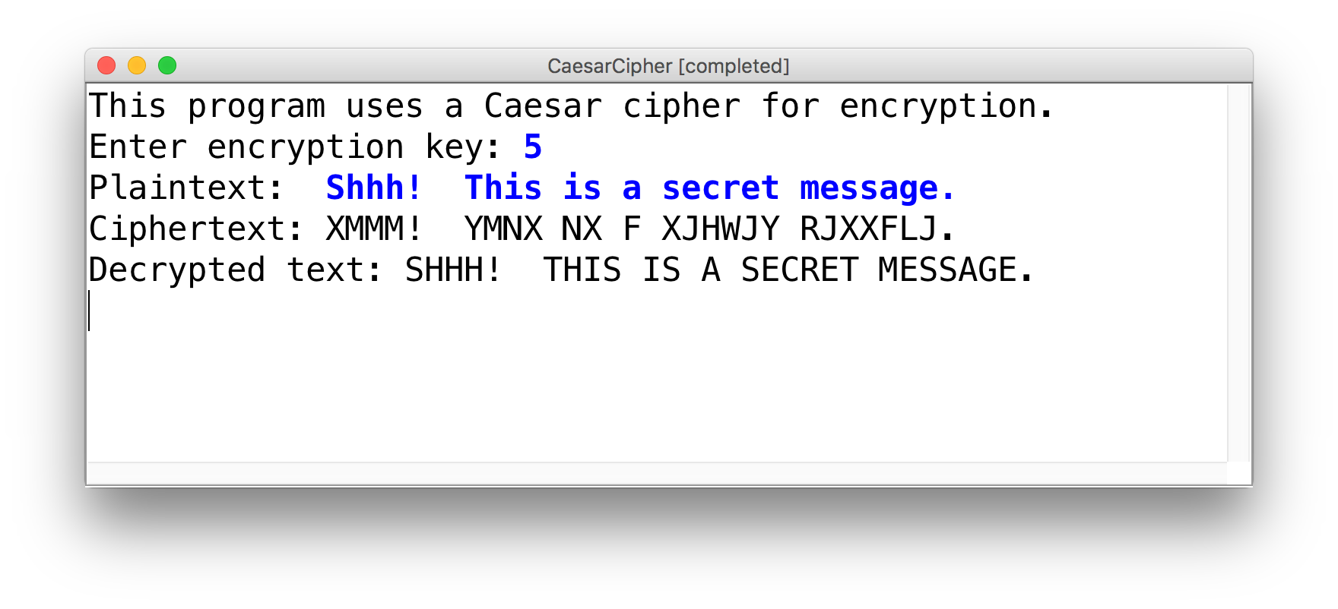
Goal
After learning text processing, we will be able to write our own encryption program!

Slide 56
Plan For Today
Announcements
Recap
Parameters
Return
Random Numbers
Text Processing
Characters
Strings

Slide 57
Char
A char is a variable type that represents a single character or “glyph”.
char letterA = 'A';
char plus = '+';
char zero = '0';
char space = ' ';
char newLine = '\n';
char tab = '\t';
char singleQuote = '\'';
char backSlash = '\\';
Notes:
Surrounded by single quotes
Can’t get char from user – but can get string, which we’ll see later

Slide 58
Char
Under the hood, Java represents each char as an integer (its “ASCII value”).
Uppercase letters are sequentially numbered
Lowercase letters are sequentially numbered
Digits are sequentially numbered
char uppercaseA = 'A'; // Actually 65
char lowercaseA = 'a'; // Actually 97
char zeroDigit = '0'; // Actually 48

Slide 59
Char Math!
We can take advantage of Java representing each char as an integer (its “ASCII value”):
boolean areEqual = 'A' == 'A'; // true
boolean earlierLetter = 'f' < 'c'; // false
char uppercaseB = 'A' + 1;
int diff = 'c' - 'a'; // 2
int numLettersInAlphabet = 'z' – 'a' + 1;
// or
int numLettersInAlphabet = 'Z' – 'A' + 1;
Notes:
Use all integer operators we have learned about

Slide 60
Char Math!
We can take advantage of Java representing each char as an integer (its “ASCII value”):
// prints out every character
for (char ch = 'a'; ch <= 'z'; ch++) {
print(ch);
}
Notes:
Not every number corresponds to a char…

Slide 61
Char Math!
Not every integer maps to a character. So when you have an expression with ints and chars, Java picks int as the most expressive type.
'A' + 1 // evaluates to 66 (int)
'c' + (2*5) – 1 // evaluates to 108
We can make it a char by putting it in a char variable.
char uppercaseB = 'A' + 1 ;
// or
char uppercaseB = 66;
Notes:
Sometimes we know what we’re doing, and we want it as a char
Another way: type casting

Slide 62
Side Note: Type-casting
If we want to force Java to treat an expression as a particular type, we can also cast it to that type.
'A' + 1 // evaluates to 66 (int)
(char)('A' + 1) // evaluates to 'B' (char)
(char)'A' + 1 // evaluates to 66 (int)
1 / 2 // evaluates to 0 (int)
(double)1 / 2 // evaluates to 0.5 (double)
1 / (double)2 // evaluates to 0.5 (double)
Notes:
Casting a role just like in a play
Casts just the first term it sees!
Don’t need to always cast
Also some Character methods, but they look weird

Slide 63
Character Methods
There are some helpful built-in Java methods to manipulate chars.
char lowercaseA = 'a';
char uppercaseA = Character.toUpperCase(lowercaseA);
char plus = '+';
if (Character.isLetter(plus)) {
... // Does not execute: + is not a letter
}

Slide 64
Character Methods
Method | Description
Character.isDigit(ch) | true if ch is '0' through '9'
Character.isLetter(ch) | true if ch is 'a' through 'z' or 'A' through 'Z'
Character.isLetterOrDigit(ch) | true if ch is 'a' through 'z', 'A' through 'Z' or '0' through '9'
Character.isLowerCase(ch) | true if ch is 'a' through 'z'
Character.isUpperCase(ch) | true if ch is 'A' through 'Z'
Character.toLowerCase(ch) | returns lowercase equivalent of a letter
Character.toUpperCase(ch) | returns uppercase equivalent of a letter
Character.isWhitespace(ch) | true if ch is a space, tab, new line, etc.
Remember: toLowerCase and toUpperCase return the new char; they cannot modify an existing char!

Slide 65
Character Methods
Remember to always save the return value of Character methods!
char lowercaseA = 'a';
Character.toUpperCase(lowercaseA); // Does nothing!
println(lowercaseA); // prints ’a’!
char uppercaseA = Character.toUpperCase(lowercaseA); // OK
println(uppercaseA); // prints ’A’!

Slide 66
Plan For Today
Announcements
Recap
Parameters
Return
Random Numbers
Text Processing
Characters
Strings

Slide 67
Strings
A String is a variable type representing a sequence of characters.
String text = "Hi parents!";
Each character is assigned an index, going from 0 to length-1
There is a char at each index
index | 0 | 1 | 2 | 3 | 4 | 5 | 6 | 7 | 8 | 9 | 10
character | 'H' | 'i' | ' ' | 'p' | 'a' | 'r' | 'e' | 'n' | 't' | 's' | '!'

Slide 68
Creating Strings
String str = "Hello, world!";
String empty = "";
println(str);
// Read in text from the user
String name = readLine("What is your name? ");
// String concatenation (using “+”)
String message = 2 + " cool " + 2 + " handle";
int x = 2;
println("x has the value " + x);
Notes:
Note that char ‘A’ is different from string “A”!

Slide 69
Common String Operations
String str = "Hello, world!";
// Length
int strLength = str.length(); // 13
// Access individual characters
char firstLetter = str.charAt(0);
char lastLetter = str.charAt(strLength – 1);
char badTimes = str.charAt(strLength); // ERROR
Notes:
Unlike char, these methods use dot syntax

Slide 70
Substrings
A substring is a subset of a string.
String str = "Hello, world!";
String hello = str.substring(0, 5);
0 | 1 | 2 | 3 | 4 | 5 | 6 | 7 | 8 | 9 | 10 | 11 | 12
'H' | 'e' | 'l' | 'l' | 'o' | ',' | ' ' | 'w' | 'o' | 'r' | 'l' | 'd' | '!'
Notes:
second index is exclusive

Slide 71
Substrings
A substring is a subset of a string.
String str = "Hello, world!";
String worldExclm = str.substring(7, 13);
0 | 1 | 2 | 3 | 4 | 5 | 6 | 7 | 8 | 9 | 10 | 11 | 12
'H' | 'e' | 'l' | 'l' | 'o' | ',' | ' ' | 'w' | 'o' | 'r' | 'l' | 'd' | '!'

Slide 72
Substrings
A substring is a subset of a string.
String str = "Hello, world!";
String worldExclm = str.substring(7); // to end
0 | 1 | 2 | 3 | 4 | 5 | 6 | 7 | 8 | 9 | 10 | 11 | 12
'H' | 'e' | 'l' | 'l' | 'o' | ',' | ' ' | 'w' | 'o' | 'r' | 'l' | 'd' | '!'

Slide 73
String Methods
Method name | Description
s.length() | number of characters in this string
s.charAt(index) | char at the given index
s.indexOf(str) | index where the start of the given string appears in this string (-1 if not found)
s.substring(index1, index2) or s.substring(index1) | the characters in this string from index1 (inclusive) to index2 (exclusive); if index2 is omitted, goes until end
s.toLowerCase() | a new string with all lowercase letters
s.toUpperCase() | a new string with all uppercase letters
These methods are called using dot notation:
String className = "CS 106yay!";
println(className.length()); // 10

Slide 74
Strings are Immutable
Once you create a String, its contents cannot be changed.
// Cannot change individual chars in the string
String typo = "Hello, warld!”;
typo.charAt(8) = ‘o’; // Error! Will not run.
To change a String, you must create a new String containing the value you want (e.g. using String methods).
String corrected = "Hello, world!”;

Slide 75
Strings are Immutable
String className = "cs 106a";
className.toUpperCase(); // does nothing!
className = className.toUpperCase(); // ✔
println(className); // CS 106A

Slide 76
Comparing Strings
String greeting = "Hello!”;
if (greeting == "Hello!") { // Doesn’t work!
...
}
// Instead:
if (greeting.equals("Hello!")) {
...
}
Always use .equals instead of == and !=

Slide 77
Comparing Strings
Method | Description
s1.equals(s2) | whether two strings contain the same characters
s1.equalsIgnoreCase(s2) | whether two strings contain the same characters, ignoring upper vs. lower case
s1.startsWith(s2) | whether s1 contains s2’s characters at start
s1.endsWith(s2) | whether s1 contains s2’s characters at end
s1.contains(s2) | whether s2 is found within s1
Notes:
Don’t have to name them these, just examples

Slide 78
Looping Over Strings
A common String programming pattern is looping over a string and operating on each character.
String str = "Hello!";
for (int i = 0; i < str.length(); i++) {
char ch = str.charAt(i);
// Do something with ch here
}

Slide 79
Looping Over Strings
A common String programming pattern is looping over a string and operating on each character.
// Prints out each letter on a separate line
String str = "Hello!";
for (int i = 0; i < str.length(); i++) {
char ch = str.charAt(i);
println(ch);
}
Notes:
Making new string on the right, putting it in variable on the left

Slide 80
Looping Over Strings
A common String programming pattern is looping over a string and operating on each character.
// Creates a new String in all caps
String str = "Hello!";
String newStr = "";
for (int i = 0; i < str.length(); i++) {
char ch = str.charAt(i);
newStr += Character.toUpperCase(ch);
}
println(newStr); // HELLO!
Notes:
Making new string on the right, putting it in variable on the left
If time: count upper case

Slide 81
Recap
Recap
Parameters
Return
Random Numbers
Text Processing
Characters
Strings
Next time: problem-solving with Strings

Slide 82
public void run() {
for(int i = 0; i < MAX_NUM; i++) {
println(i + "! = " + factorial(i));
}
}
4

Slide 83
public void run() {
for(int i = 0; i < MAX_NUM; i++) {
println(i + "! = " + factorial(i));
}
}

Slide 84
public void run() {
for(int i = 0; i < MAX_NUM; i++) {
println(i + "! = " + factorial(i));
}
}
i
0

Slide 85
public void run() {
for(int i = 0; i < MAX_NUM; i++) {
println(i + "! = " + factorial(i));
}
}
i
0

Slide 86
public void run() {
for(int i = 0; i < MAX_NUM; i++) {
println(i + "! = " + factorial(i));
}
}
i
0
Notes:
have to evaluate expression inside of println

Slide 87
public void run() {
for(int i = 0; i < MAX_NUM; i++) {
println(i + "! = " + factorial(i));
}
}
i
0

Slide 88
public void run() {
for(int i = 0; i < MAX_NUM; i++) {
println(i + "! = " + factorial(i));
}
}
private int factorial(int n) {
int result = 1;
for (int i = 1; i <= n; i++) {
result *= i;
}
return result;
}
0
i
n
0
result
i

Slide 89
public void run() {
for(int i = 0; i < MAX_NUM; i++) {
println(i + "! = " + factorial(i));
}
}
private int factorial(int n) {
int result = 1;
for (int i = 1; i <= n; i++) {
result *= i;
}
return result;
}
0
i
n
0
1
result
i

Slide 90
public void run() {
for(int i = 0; i < MAX_NUM; i++) {
println(i + "! = " + factorial(i));
}
}
private int factorial(int n) {
int result = 1;
for (int i = 1; i <= n; i++) {
result *= i;
}
return result;
}
0
i
n
0
result
1
i
1

Slide 91
public void run() {
for(int i = 0; i < MAX_NUM; i++) {
println(i + "! = " + factorial(i));
}
}
private int factorial(int n) {
int result = 1;
for (int i = 1; i <= n; i++) {
result *= i;
}
return result;
}
0
i
n
0
1
1
result
i

Slide 92
public void run() {
for(int i = 0; i < MAX_NUM; i++) {
println(i + "! = " + factorial(i));
}
}
private int factorial(int n) {
int result = 1;
for (int i = 1; i <= n; i++) {
result *= i;
}
return result;
}
0
i
n
0
1
1
result
i

Slide 93
public void run() {
for(int i = 0; i < MAX_NUM; i++) {
println(i + "! = " + factorial(i));
}
}
1
i
0

Slide 94
public void run() {
for(int i = 0; i < MAX_NUM; i++) {
println(i + "! = " + factorial(i));
}
}
1
i
0
0! = 1

Slide 95
public void run() {
for(int i = 0; i < MAX_NUM; i++) {
println(i + "! = " + factorial(i));
}
}
i
0
0! = 1

Slide 96
public void run() {
for(int i = 0; i < MAX_NUM; i++) {
println(i + "! = " + factorial(i));
}
}
i
1
0! = 1

Slide 97
public void run() {
for(int i = 0; i < MAX_NUM; i++) {
println(i + "! = " + factorial(i));
}
}
i
1
0! = 1

Slide 98
public void run() {
for(int i = 0; i < MAX_NUM; i++) {
println(i + "! = " + factorial(i));
}
}
i
1
0! = 1

Slide 99
public void run() {
for(int i = 0; i < MAX_NUM; i++) {
println(i + "! = " + factorial(i));
}
}
i
1
0! = 1

Slide 100
public void run() {
for(int i = 0; i < MAX_NUM; i++) {
println(i + "! = " + factorial(i));
}
}
private int factorial(int n) {
int result = 1;
for (int i = 1; i <= n; i++) {
result *= i;
}
return result;
}
0
i
n
1
result
i
0! = 1

Slide 101
public void run() {
for(int i = 0; i < MAX_NUM; i++) {
println(i + "! = " + factorial(i));
}
}
private int factorial(int n) {
int result = 1;
for (int i = 1; i <= n; i++) {
result *= i;
}
return result;
}
0
i
n
1
result
1
i
0! = 1

Slide 102
public void run() {
for(int i = 0; i < MAX_NUM; i++) {
println(i + "! = " + factorial(i));
}
}
private int factorial(int n) {
int result = 1;
for (int i = 1; i <= n; i++) {
result *= i;
}
return result;
}
0
i
n
1
1
1
result
i
0! = 1

Slide 103
public void run() {
for(int i = 0; i < MAX_NUM; i++) {
println(i + "! = " + factorial(i));
}
}
private int factorial(int n) {
int result = 1;
for (int i = 1; i <= n; i++) {
result *= i;
}
return result;
}
0
i
n
1
1
1
result
i
0! = 1

Slide 104
public void run() {
for(int i = 0; i < MAX_NUM; i++) {
println(i + "! = " + factorial(i));
}
}
private int factorial(int n) {
int result = 1;
for (int i = 1; i <= n; i++) {
result *= i;
}
return result;
}
0
i
n
1
1
1
result
i
0! = 1

Slide 105
public void run() {
for(int i = 0; i < MAX_NUM; i++) {
println(i + "! = " + factorial(i));
}
}
private int factorial(int n) {
int result = 1;
for (int i = 1; i <= n; i++) {
result *= i;
}
return result;
}
0
i
n
1
1
1
result
i
0! = 1

Slide 106
public void run() {
for(int i = 0; i < MAX_NUM; i++) {
println(i + "! = " + factorial(i));
}
}
private int factorial(int n) {
int result = 1;
for (int i = 1; i <= n; i++) {
result *= i;
}
return result;
}
0
i
n
1
1
2
result
i
0! = 1

Slide 107
public void run() {
for(int i = 0; i < MAX_NUM; i++) {
println(i + "! = " + factorial(i));
}
}
private int factorial(int n) {
int result = 1;
for (int i = 1; i <= n; i++) {
result *= i;
}
return result;
}
0
i
n
1
1
2
result
i
0! = 1

Slide 108
public void run() {
for(int i = 0; i < MAX_NUM; i++) {
println(i + "! = " + factorial(i));
}
}
private int factorial(int n) {
int result = 1;
for (int i = 1; i <= n; i++) {
result *= i;
}
return result;
}
0
i
n
1
1
2
result
i
0! = 1

Slide 109
public void run() {
for(int i = 0; i < MAX_NUM; i++) {
println(i + "! = " + factorial(i));
}
}
1
i
1
0! = 1

Slide 110
public void run() {
for(int i = 0; i < MAX_NUM; i++) {
println(i + "! = " + factorial(i));
}
}
1
i
1
0! = 1
1! = 1

Slide 111
public void run() {
for(int i = 0; i < MAX_NUM; i++) {
println(i + "! = " + factorial(i));
}
}
i
1
0! = 1
1! = 1

Slide 112
public void run() {
for(int i = 0; i < MAX_NUM; i++) {
println(i + "! = " + factorial(i));
}
}
i
2
0! = 1
1! = 1

Slide 113
public void run() {
for(int i = 0; i < MAX_NUM; i++) {
println(i + "! = " + factorial(i));
}
}
i
2
0! = 1
1! = 1

Slide 114
public void run() {
for(int i = 0; i < MAX_NUM; i++) {
println(i + "! = " + factorial(i));
}
}
i
2
0! = 1
1! = 1

Slide 115
public void run() {
for(int i = 0; i < MAX_NUM; i++) {
println(i + "! = " + factorial(i));
}
}
i
2
0! = 1
1! = 1

Slide 116
public void run() {
for(int i = 0; i < MAX_NUM; i++) {
println(i + "! = " + factorial(i));
}
}
2
i
2
0! = 1
1! = 1

Slide 117
public void run() {
for(int i = 0; i < MAX_NUM; i++) {
println(i + "! = " + factorial(i));
}
}
2
i
2
0! = 1
1! = 1
2! = 2

Slide 118
public void run() {
for(int i = 0; i < MAX_NUM; i++) {
println(i + "! = " + factorial(i));
}
}
i
2
0! = 1
1! = 1
2! = 2

Slide 119
public void run() {
for(int i = 0; i < MAX_NUM; i++) {
println(i + "! = " + factorial(i));
}
}
i
3
0! = 1
1! = 1
2! = 2

Slide 120
public void run() {
for(int i = 0; i < MAX_NUM; i++) {
println(i + "! = " + factorial(i));
}
}
i
3
0! = 1
1! = 1
2! = 2

Slide 121
public void run() {
for(int i = 0; i < MAX_NUM; i++) {
println(i + "! = " + factorial(i));
}
}
i
3
0! = 1
1! = 1
2! = 2

Slide 122
public void run() {
for(int i = 0; i < MAX_NUM; i++) {
println(i + "! = " + factorial(i));
}
}
i
3
0! = 1
1! = 1
2! = 2

Slide 123
public void run() {
for(int i = 0; i < MAX_NUM; i++) {
println(i + "! = " + factorial(i));
}
}
6
i
3
0! = 1
1! = 1
2! = 2

Slide 124
public void run() {
for(int i = 0; i < MAX_NUM; i++) {
println(i + "! = " + factorial(i));
}
}
6
i
3
0! = 1
1! = 1
2! = 2
3! = 6

Slide 125
public void run() {
for(int i = 0; i < MAX_NUM; i++) {
println(i + "! = " + factorial(i));
}
}
i
3
0! = 1
1! = 1
2! = 2
3! = 6

Slide 126
public void run() {
for(int i = 0; i < MAX_NUM; i++) {
println(i + "! = " + factorial(i));
}
}
i
4
0! = 1
1! = 1
2! = 2
3! = 6

Slide 127
public void run() {
for(int i = 0; i < MAX_NUM; i++) {
println(i + "! = " + factorial(i));
}
}
i
4
0! = 1
1! = 1
2! = 2
3! = 6

